Slide 1

Exploratory Data Analysis
Cab Investment Firm Insight
June 14, 2023
Christopher Perng

Slide 2
Data Exploration
Data Sets:
Cab_Data.csv
Customer_ID.csv
Transaction_ID.csv
City.csv
Master data includes 355,032 rows of data
Created ‘Profit’ column from price charged and cost of trip
Created ‘Year’, ‘Month’, ‘Day’, ‘Week’, 4 columns for further analysis
Time period included: 2016/01/31 – 2018/12/31

Slide 3
Questions
Which company has maximum cab users at a particular time period?
Which company makes the most profit from time to time?
Is there a significant difference in customer gender?
What kind of income level take cab more often?
Is there a difference in customer age?
Which company has a better return frequency?
Is there a seasonality trend in the data?
Which distance travelled has the most customer?
Which company is likely to perform better in the future?

Slide 4
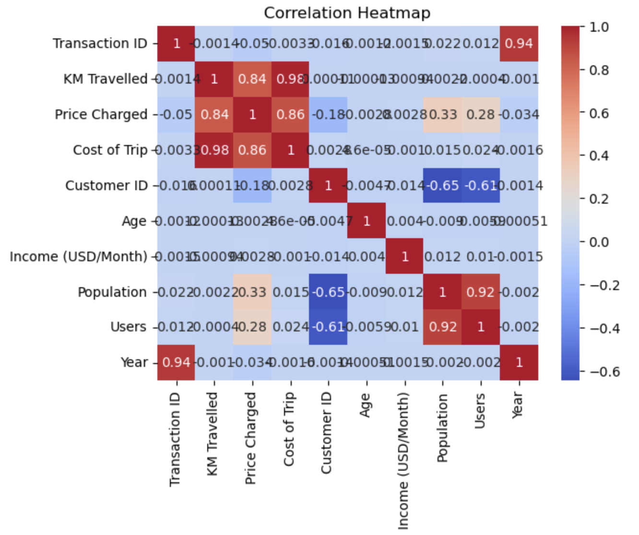
Data relationship
We the correlation heatmap, we can observe that:
Cost of Trip to KM Travelled
Cost of Trip to Price Charged
Price Charged to KM Travelled
Users to Population
These 4 variables have a strong relationship

Slide 5
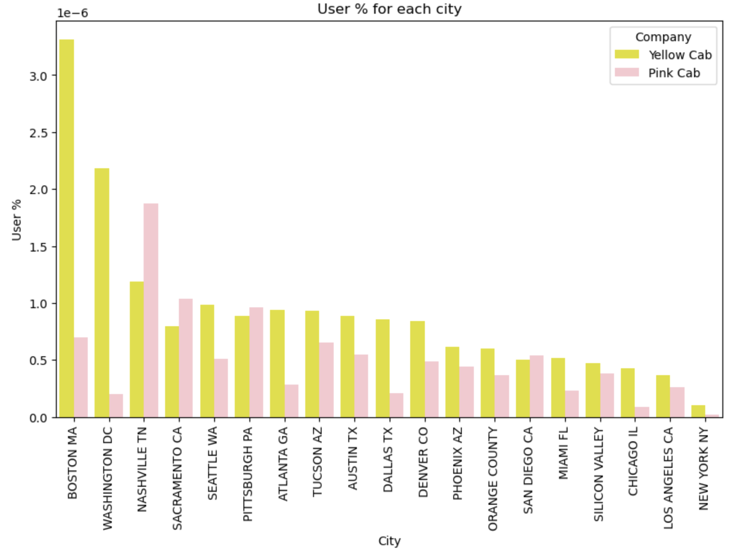
User % for each city
--Yellow Cab Company has more percentage of users in almost every cities, except for:
Nashville TN
Sacremento CA
Pittsburgh PA
San Diego CA

Slide 6
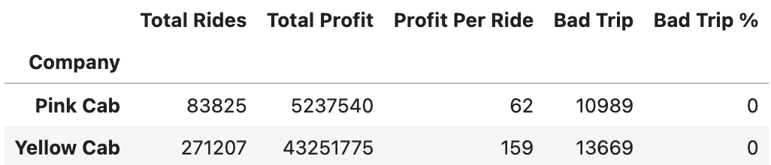
Profit Analysis
Yellow Cab company has earned 8.25 times more profit in total than the Pink Cab company
Yellow Cab company made 2.55 times more profit per ride than the Pink Cab company
Yellow Cab company has 38% less non-profit trips than the Pink Cab company

Slide 7
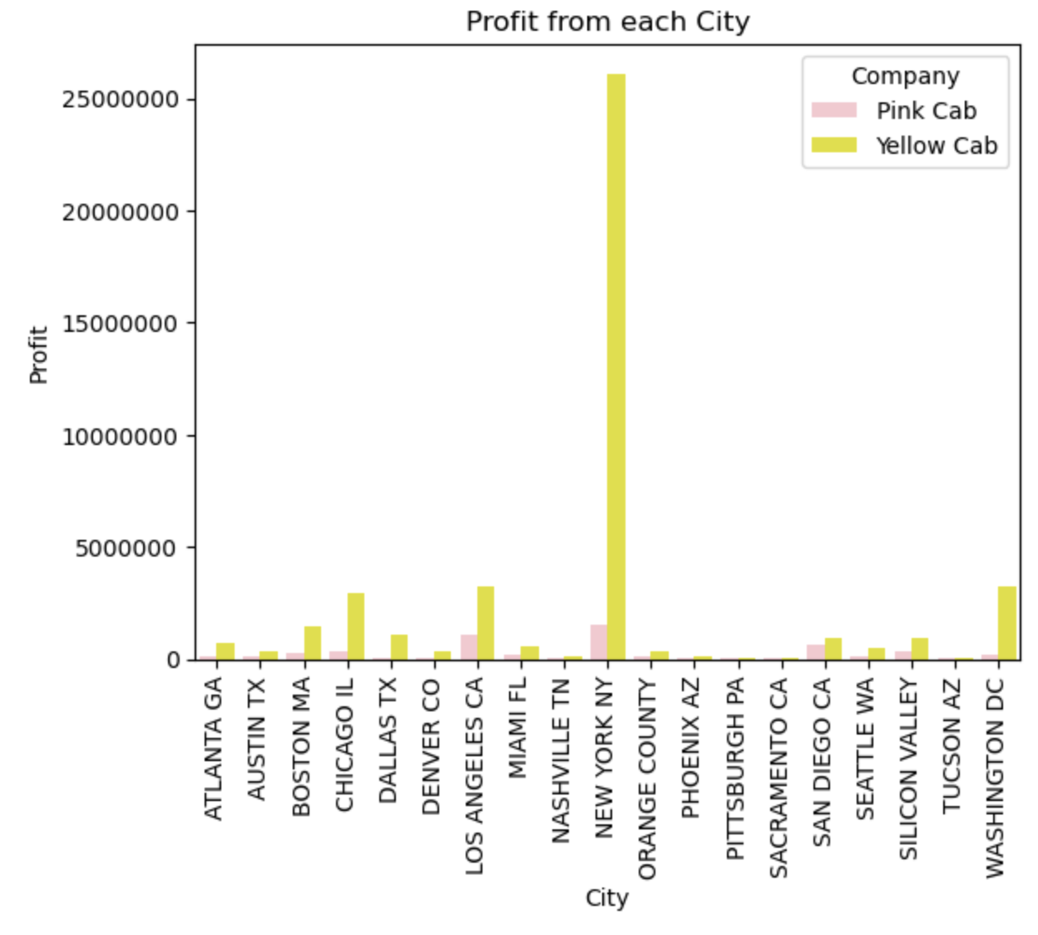
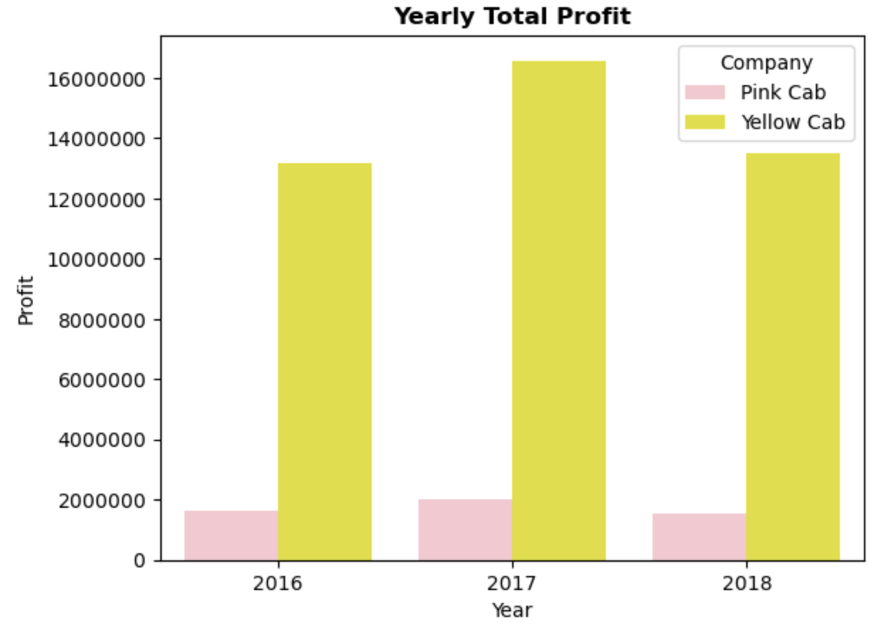
Profit Analysis

Slide 8
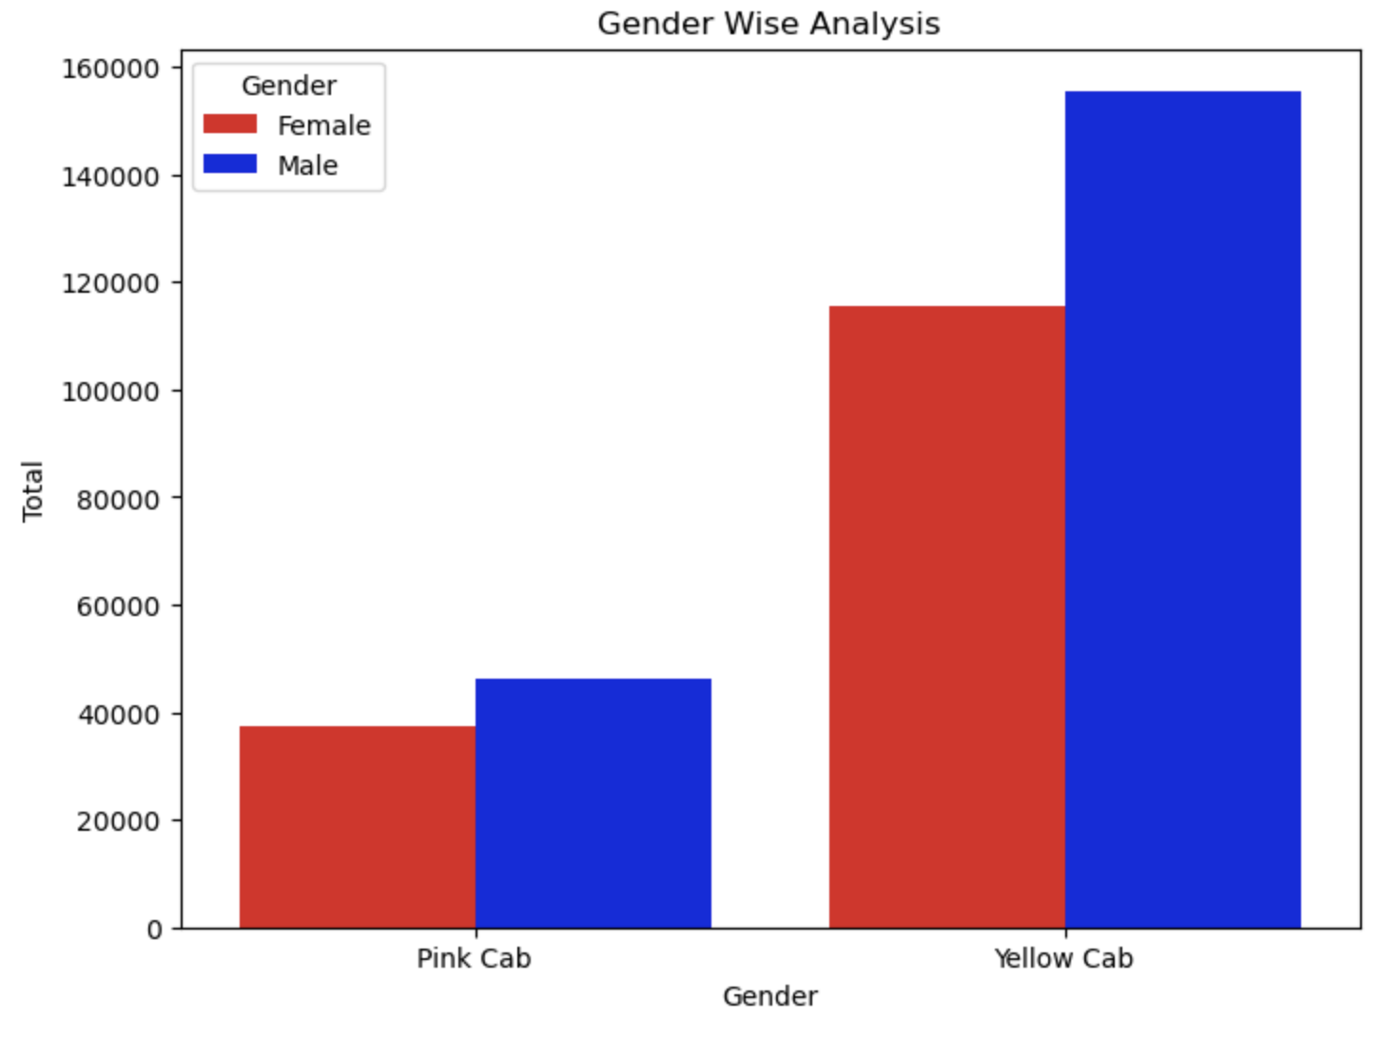
Gender Wise Analysis

Slide 9
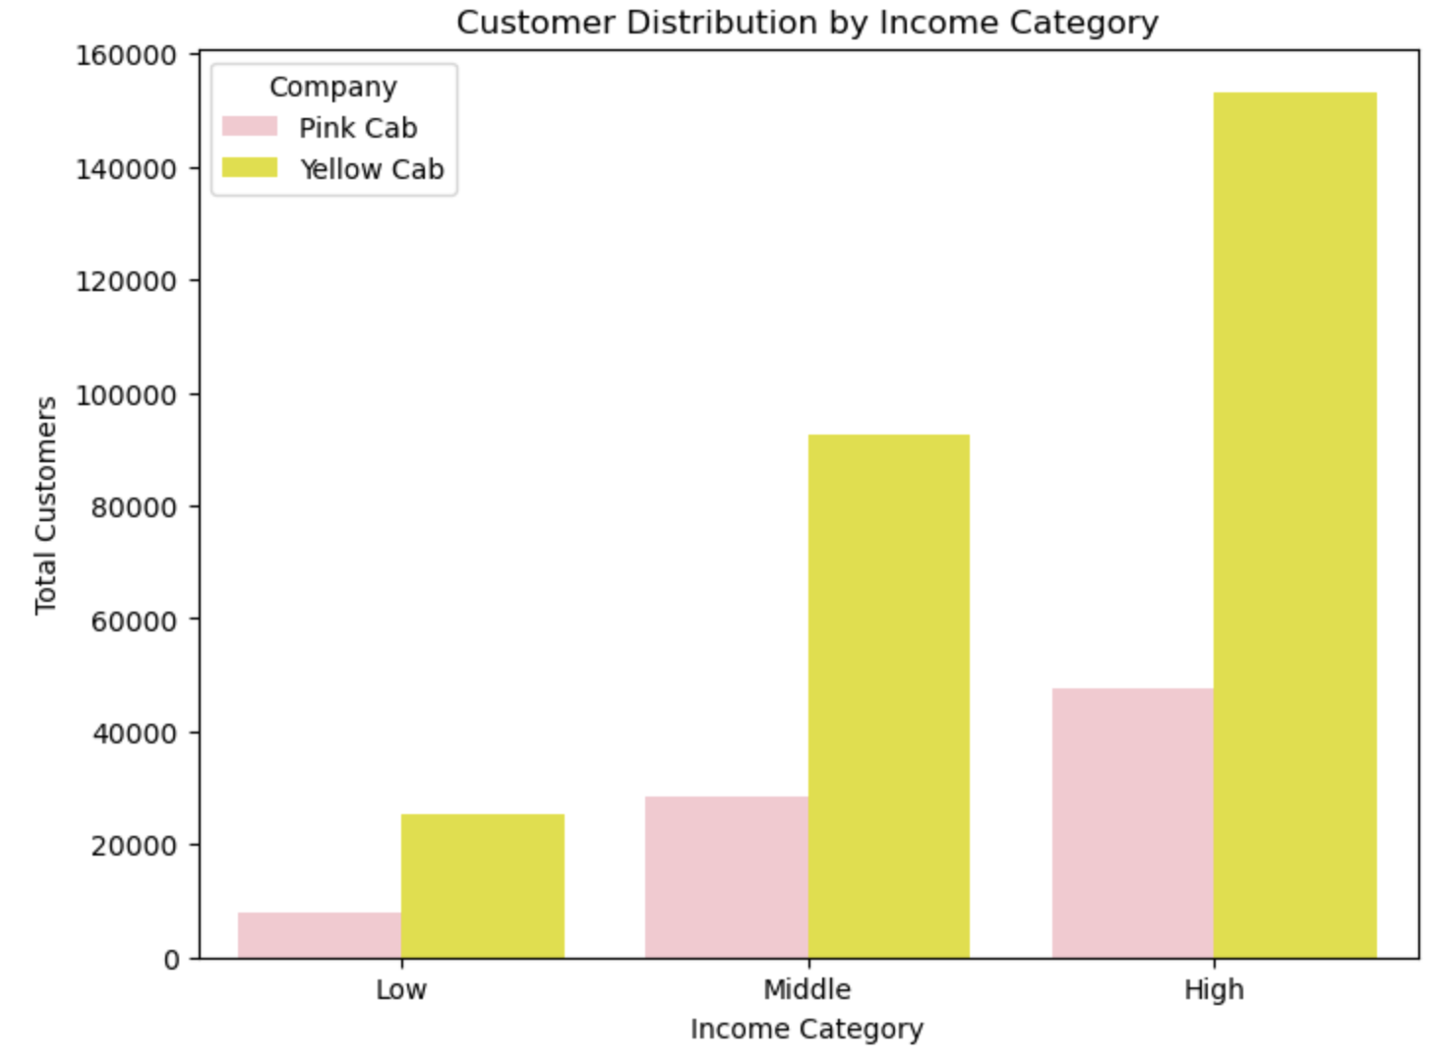
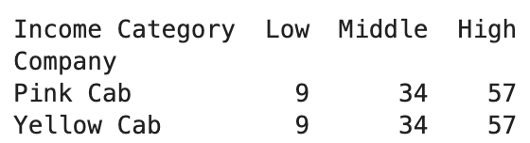
Income Analysis
We can see that the distribution of the income has the same percentage for both companies. Both companies have customer based from the Middle and High income class

Slide 10
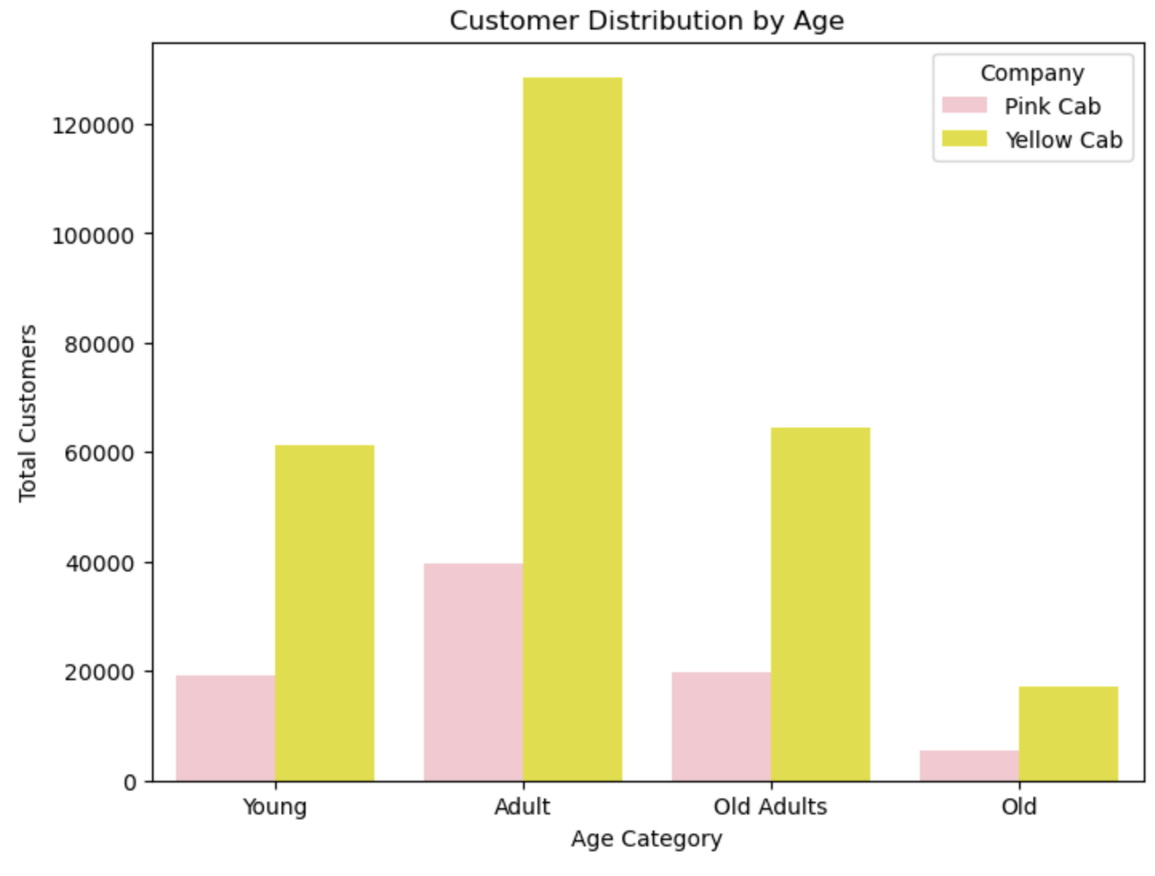
Age Analysis
Most customer are aged from 26 to 40 years old. Has same distribution for both companies.

Slide 11
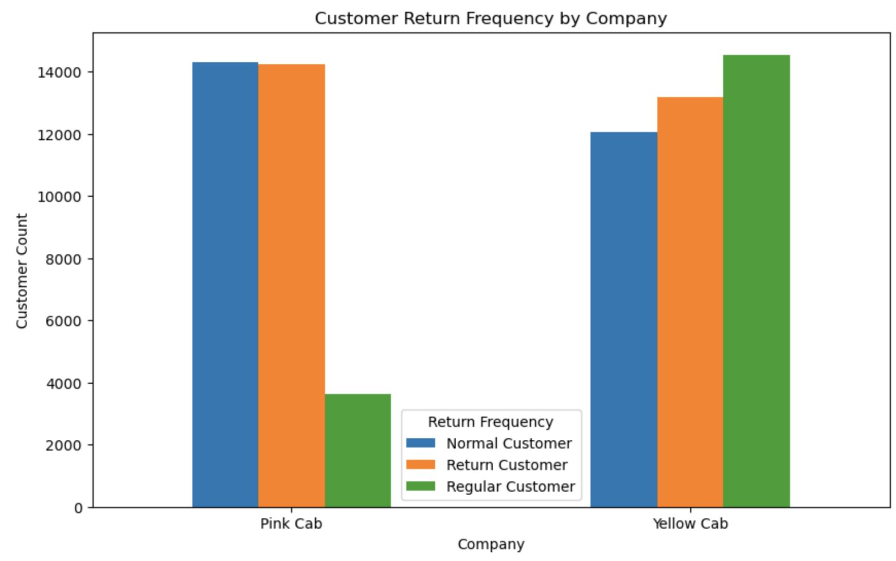
Return Frequency
The Yellow Cab company has 4 times more regular customer than the Pink Cab company. This might be the reason for the significant difference in profit

Slide 12
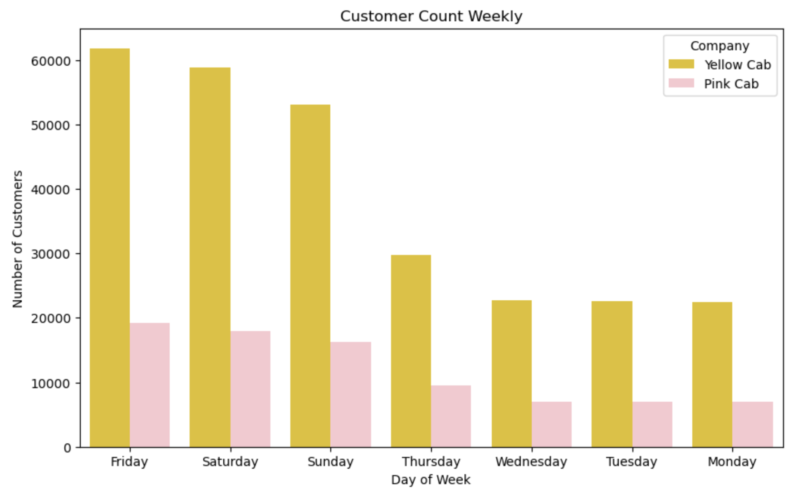
Weekly Analysis
Both company have the same trend weekly, most customers take a cab on Friday, Saturday and Sunday.

Slide 13
Recommendations
To summarize, here are some insights from the analysis:
Yellow Cab company has more percentage of users in most of the cities except for 4
Yellow Cab company has earned 8.25 times more profit in total than the Pink Cab company
Yellow Cab company made 2.55 times more profit per ride than the Pink Cab company
Yellow Cab company has 38% less non-profit trips than the Pink Cab company
The Yellow Cab company has 4 times more regular customers than the Pink Cab company
Based on our analysis, we recommend Yellow Cab for investment.

Slide 14
THANK YOU

